Slide 1



A Kinematic Analysis of Proplyds in NGC 1977 and the Orion Nebula Cluster
Peter Hartman, J. Serena Kim, Thomas Haworth, Marina Kounkel, Min Fang, Carlos Roman-Zuniga

Slide 2
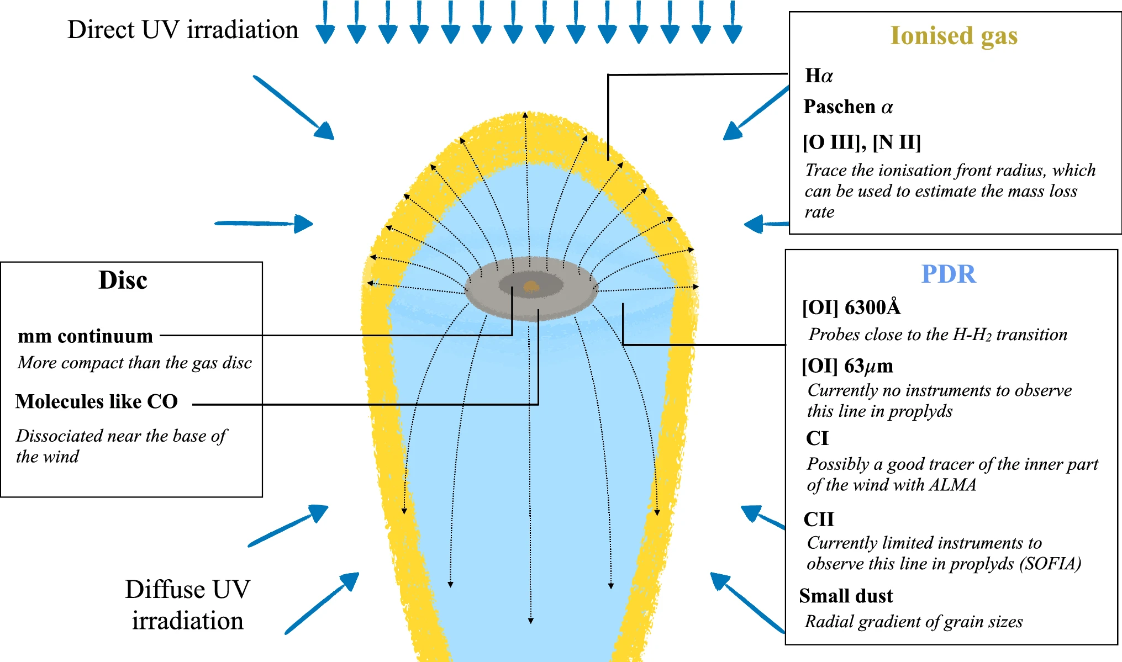
Proplyds
Photoevaporating protoplanetary disks
Evaporated by UV radiation
Images from: Ricci+08
Winter, Haworth 2022

Slide 3
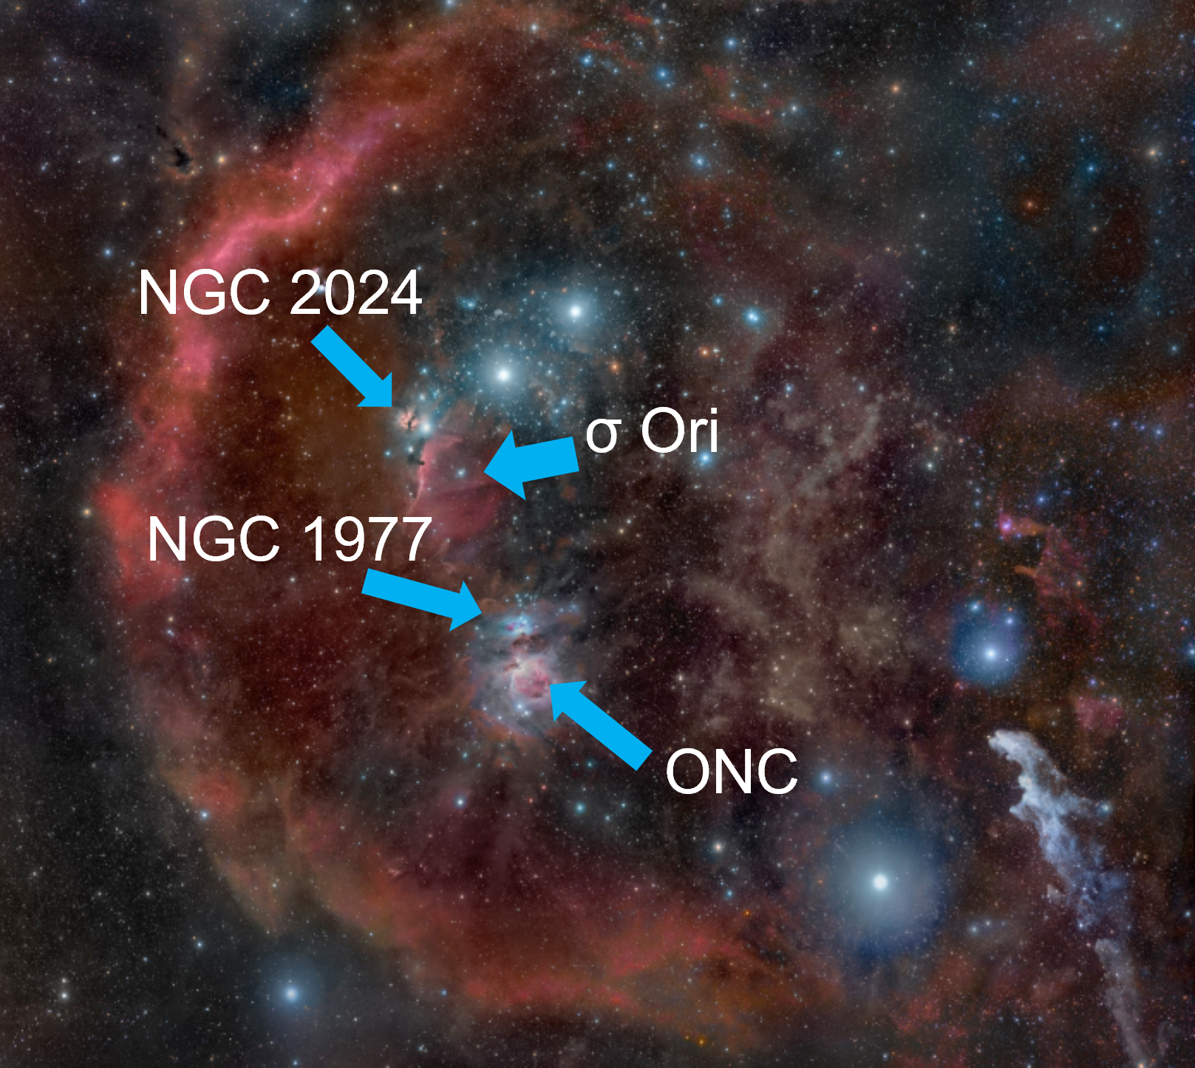
The Orion Nebula Cluster (ONC) and NGC 1977
The heart of the Orion Nebula and its sibling
ONC is a high-UV environment
NGC 1977 is an intermediate-UV environment
Ages
ONC and NGC 1977: 1-2 Myr
FUV Environments
ONC: >50,000-100,000 G₀
NGC 1977: ~3,000 G₀
NGC 1977 is similar likely birthplaces for Sun-like stars
Background Image from Rogelio Bernal Andreo

Slide 4
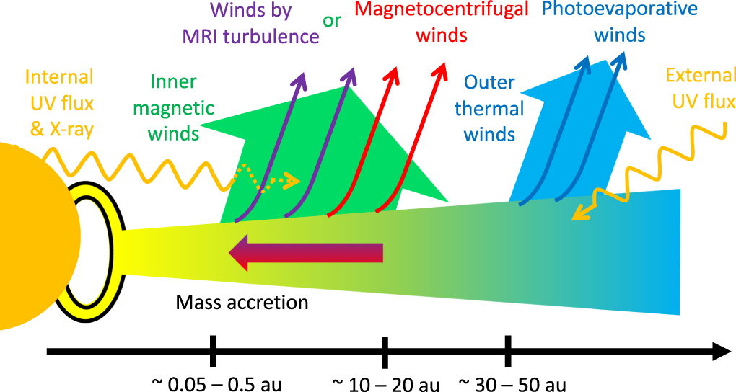
Proplyd Lifetime Problem
Proplyds deplete in only 10,000-100,000 years (Haworth 2021, Henny&O’Dell 1999)
The ONC and NGC 1977 are both 1-2 Myrs in age
Hasegawa+2022

Slide 5


Kinematic Data
Proper Motion and Parallax from the Gaia Mission’s third data release (DR3)
Radial Velocity from the Sloan Digital Sky Survey (SDSS)
Used to determine 3D space velocities

Slide 6
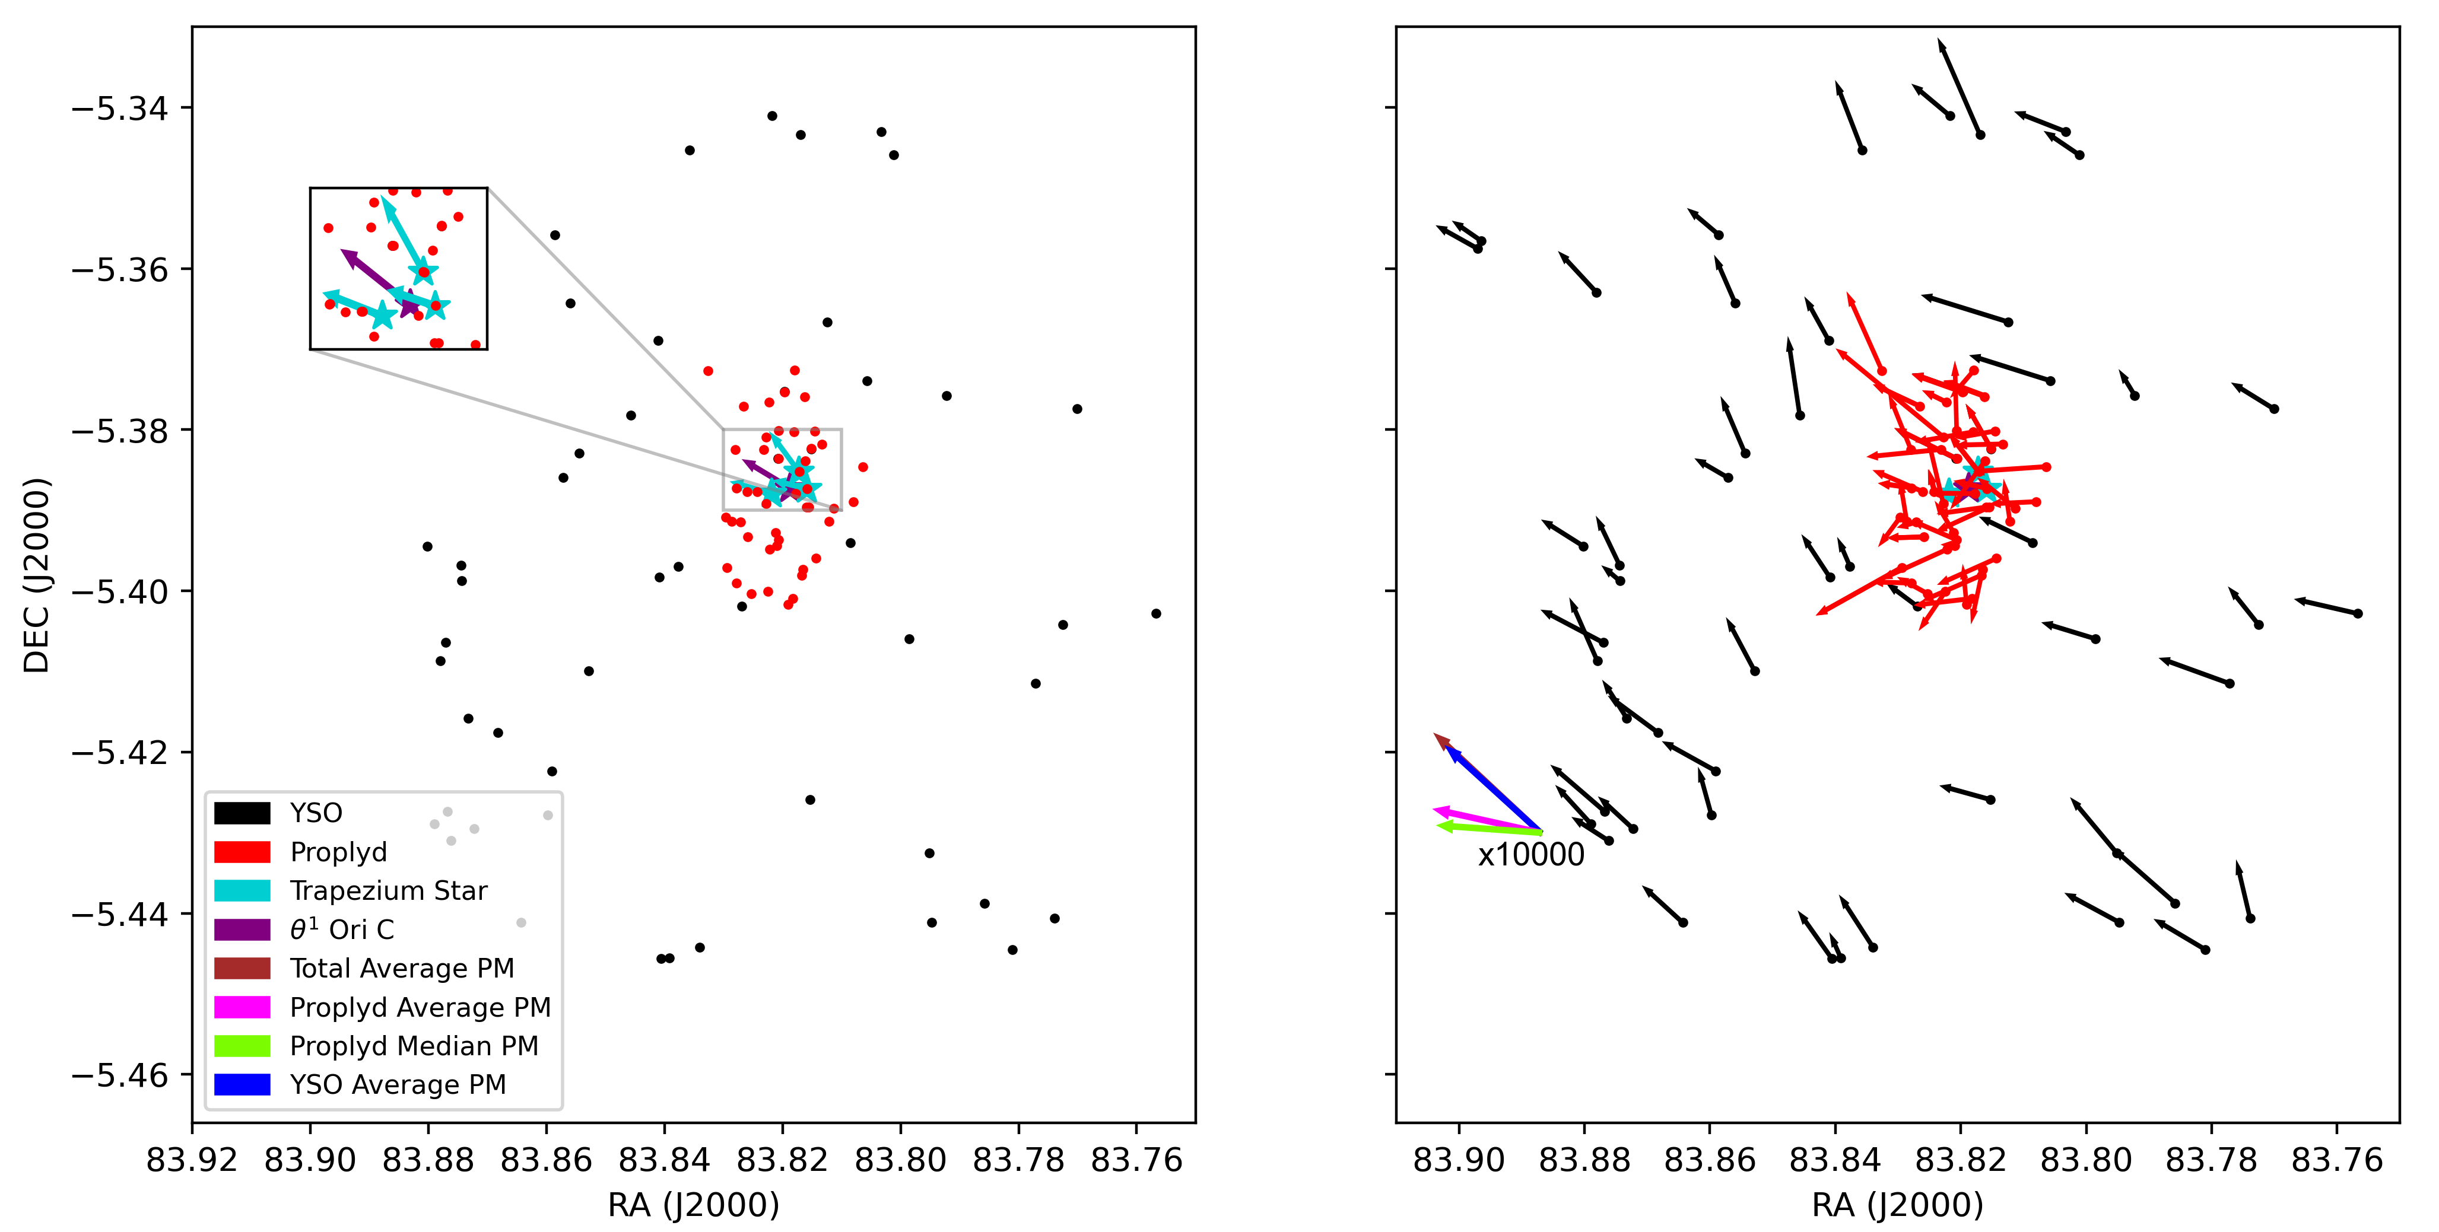
ONC Kinematic Results

Slide 7
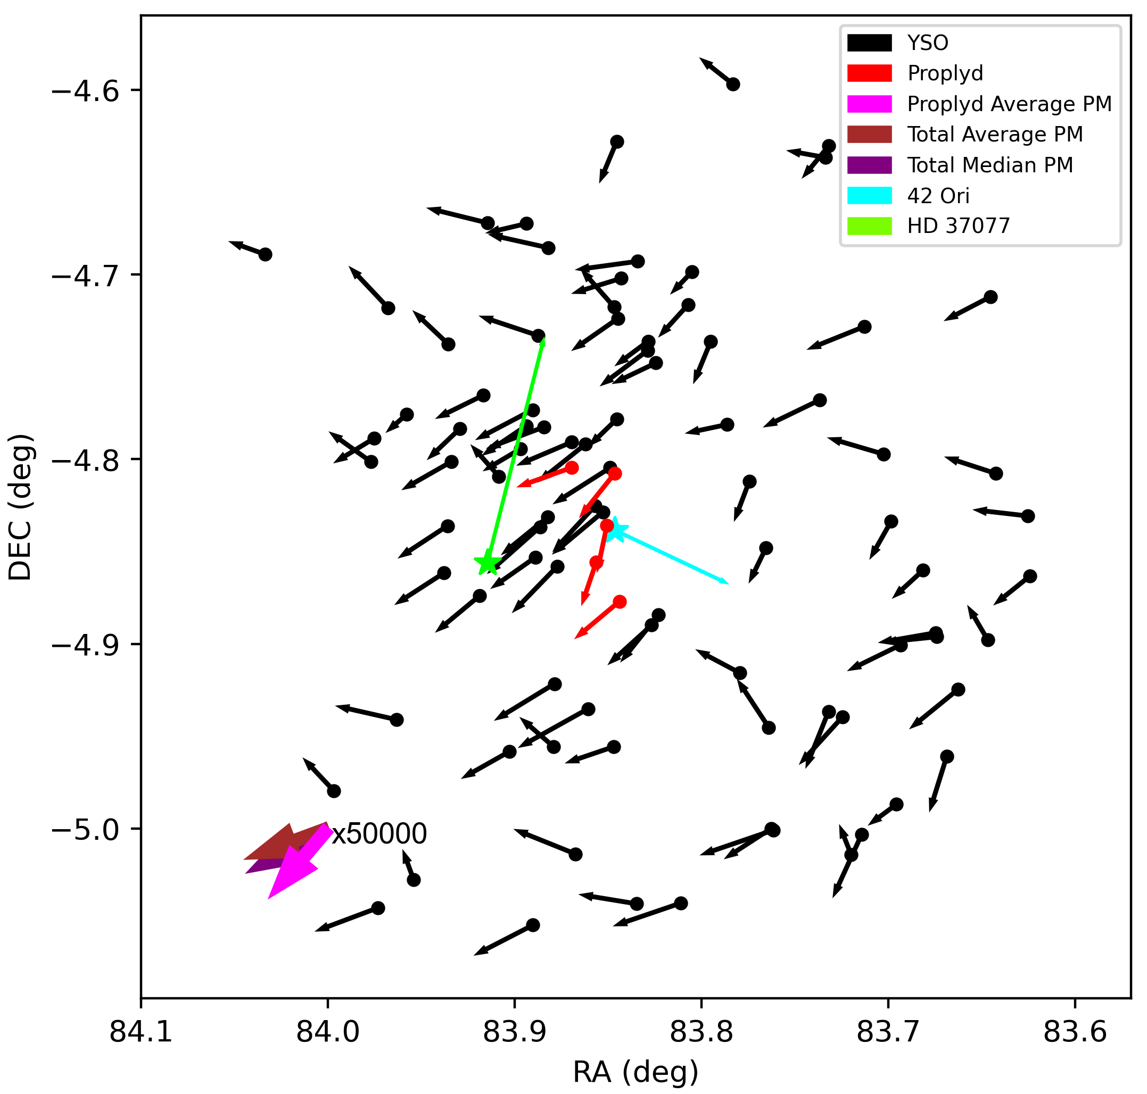
NGC 1977 Kinematic Results

Slide 8
Discussion and Summary
In NGC 1977 many YSOs have been exposed to FUV radiation from 42 Ori through its motion, recently exposed YSOs still show proplyds and more can still form
In the ONC, Trapezium stars and proplyds show similar PMs (more random in one direction), while YSOs do not show such PMs.
Further work will include other regions in Orion to get a broader sense of proplyd populations

Slide 9
I would like to thank all of these people for their support:
Dr. Serena Kim, my advisor
Shae Henley, Rey Squillace, and Jacob Blais for their work as advisors
Michelle Coe, for organizing the Space Grant Program
Dr. Chandra Holifield Collins and Dr. Yancy Shirley for advice on creating my presentation
The Space Grant Program for providing funding to my research
Steward Observatory for providing the opportunity for me to succeed in my research

Slide 10
Thank You!

